Slide 1

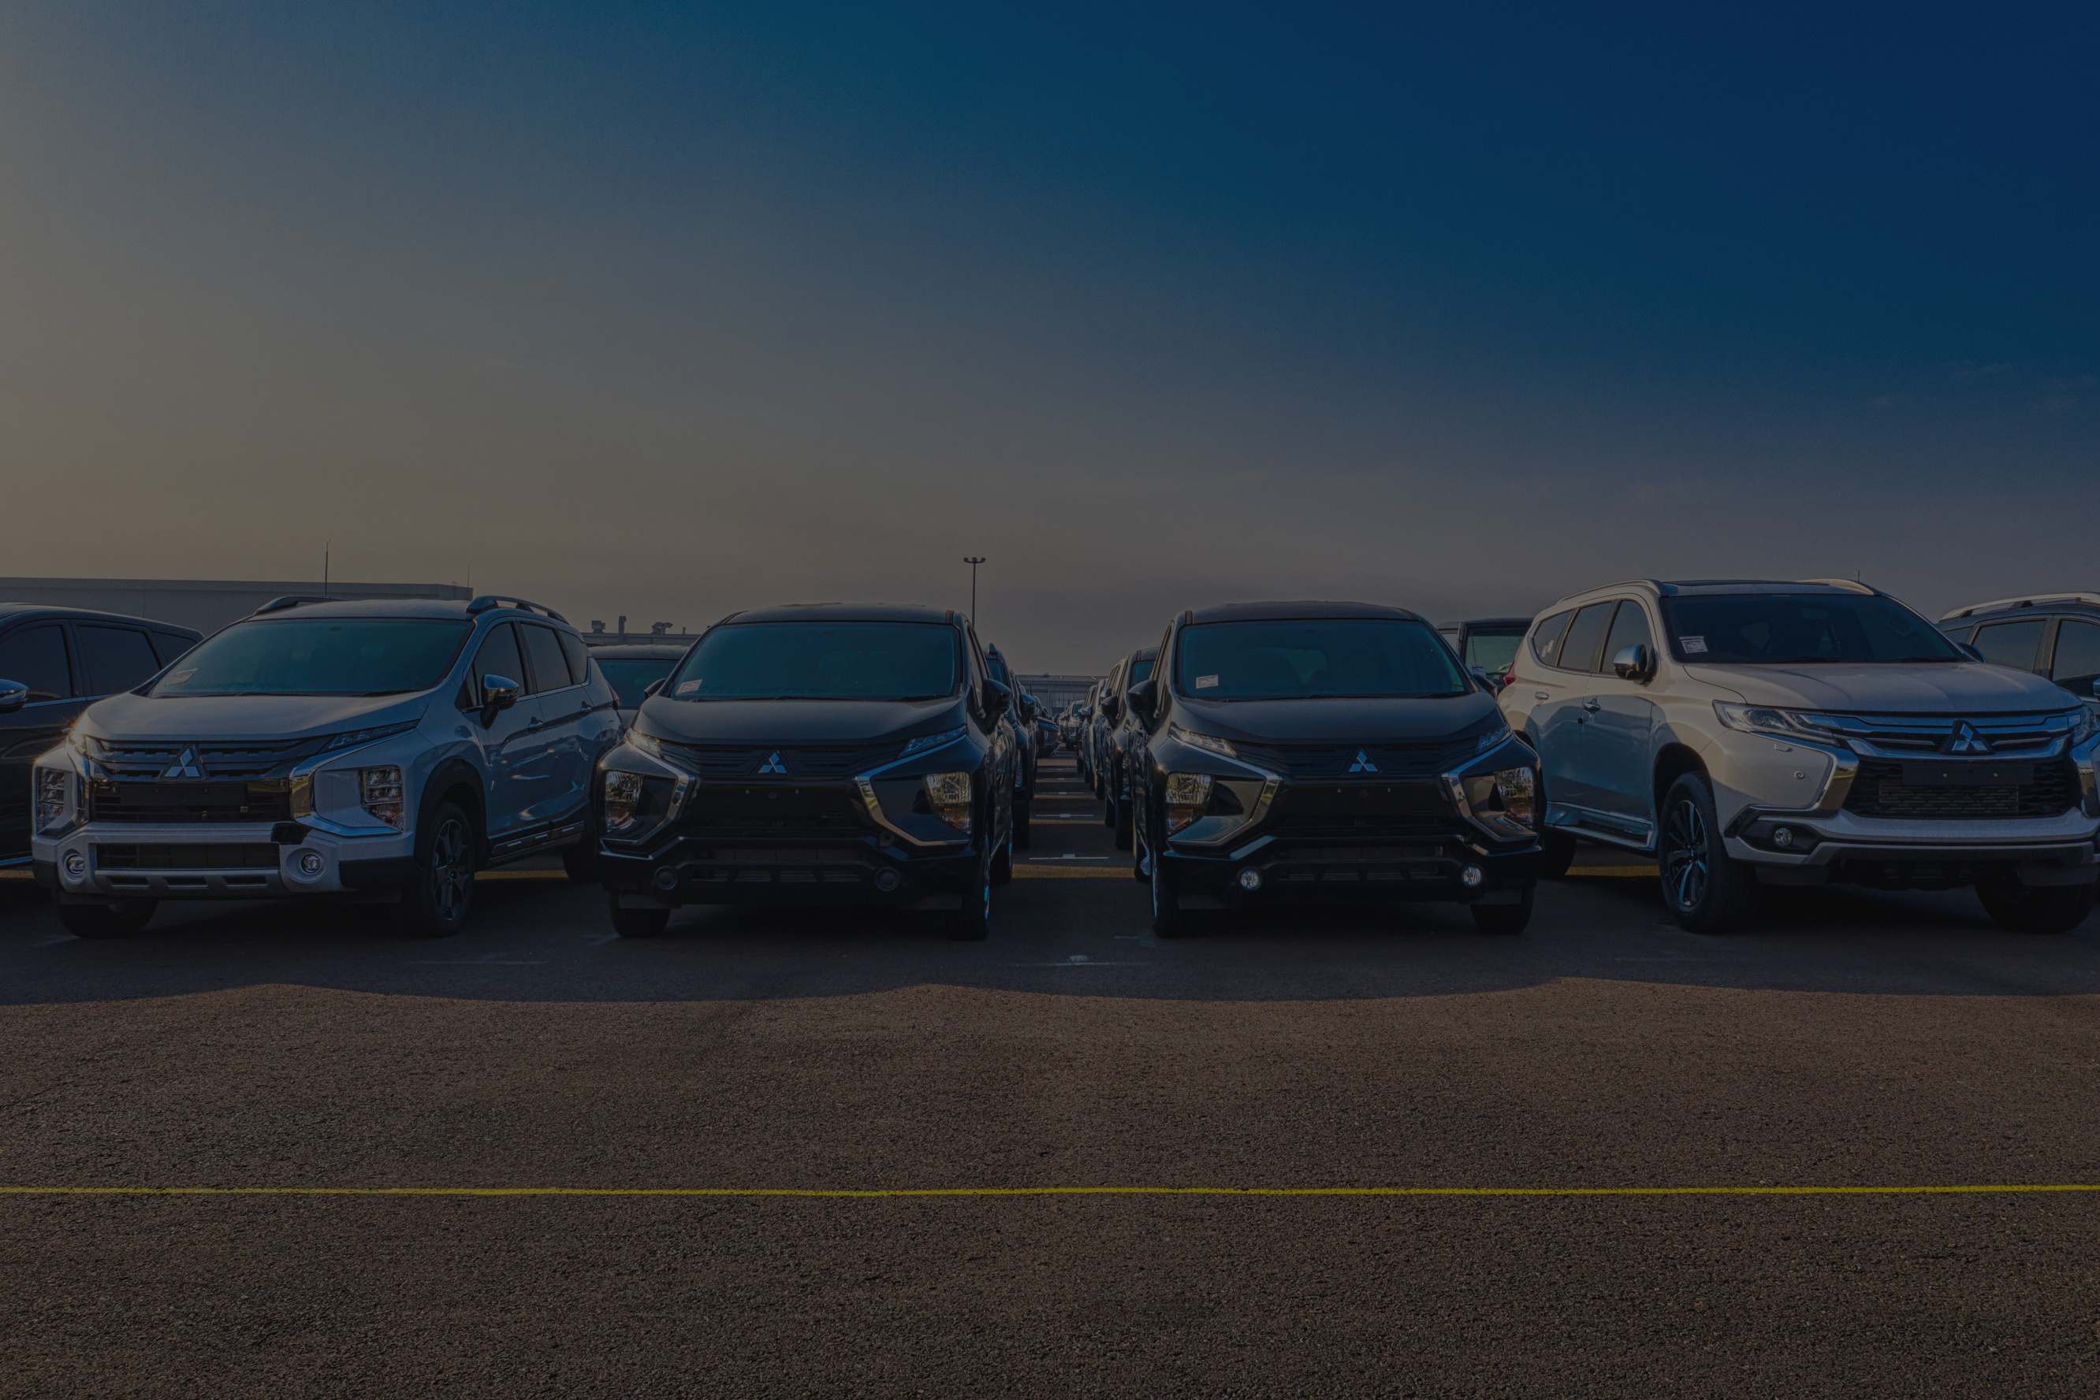

An analysis of consumer demand and market drivers during the festive period
By Shreeya Gupta

Slide 2

CONTENT
FESTIVE SEASON OUTLOOK: VEHICLE SALES (CONTEXT & PREDICTIONS)
RESEARCH AND METHOD
FINDINGS & ANALYSIS
CONCLUSION
This investigatory project evaluates festive season vehicle sales trends in India using real-world data. The research aims to provide insightful recommendations for understanding consumer demand patterns and supporting strategic decision-making in the automotive industry.
Github Code - Link

Slide 3


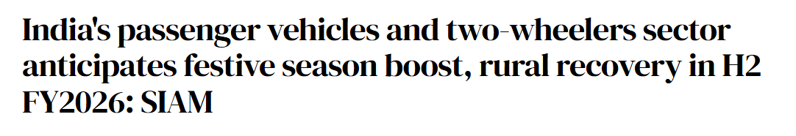

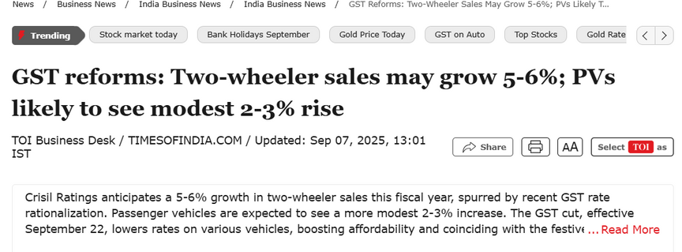
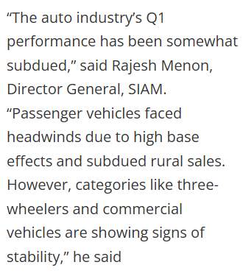

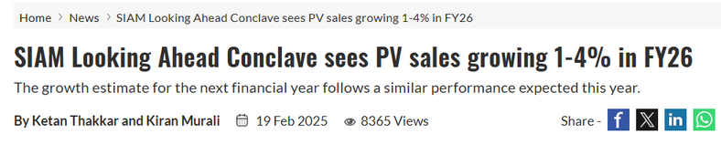


Festive Season Outlook: Vehicle Sales (Context & Predictions)
Festive season = high-demand phase
Historically, new model launches, promotional offers, and cultural buying sentiment drive growth in both passenger vehicles (PV) and two-wheelers (2W).
The Society of Indian Automobile Manufacturers (SIAM) states that the upcoming festive season typically serves as a key demand driver, especially with a supportive monsoon and reduced borrowing costs. The Tribune
At the SIAM Looking Ahead Conclave, PV sales growth for FY 2025-26 is projected at 1–4%, with multiple OEMs expressing cautious optimism.

Slide 4




SOURCES.
RESEARCH
To ground this analysis, I looked at multiple trusted sources. FADA and SIAM provide the official retail and wholesale numbers. I also checked industry media like ET Auto and Business Standard for festive forecasts, and OEM press releases for new launches and offers.
What these sources highlight is that festive demand is driven by three key signals: strong promotional activity, consumer preference for buying during this season, and multiple new launches especially in EVs and compact SUVs. Additionally, a good monsoon is expected to support rural demand in two-wheelers and tractors.

Slide 5





Gathered vehicle sales data from internet sources (industry reports, FADA datasets, news articles).
Applied Matplotlib and Seaborn to generate charts, identify trends, and derive insights.
Data Collection
Data Visualization
METHOD
Data Preparation
Data Processing
Cleaned and structured the raw data → converted into Excel format for easy handling.
Imported the dataset into Google Colab and organized it using Pandas for analysis.

Slide 6
FINDINGS

Slide 7

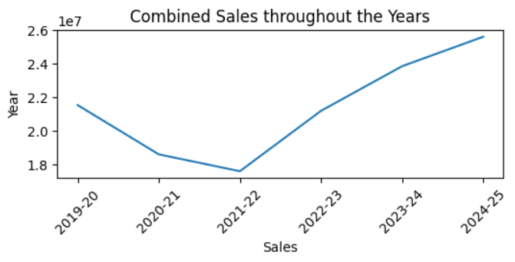
Combined Sales throughout the Years (2019–2025)
Sales dipped sharply in 2020–21 and 2021–22, reflecting the COVID-19 impact and slower recovery.
From 2022–23 onwards, there is a steady and strong rebound.
The trend suggests pent-up demand + structural recovery in the auto sector, setting up a positive festive season outlook for 2025.

Slide 8
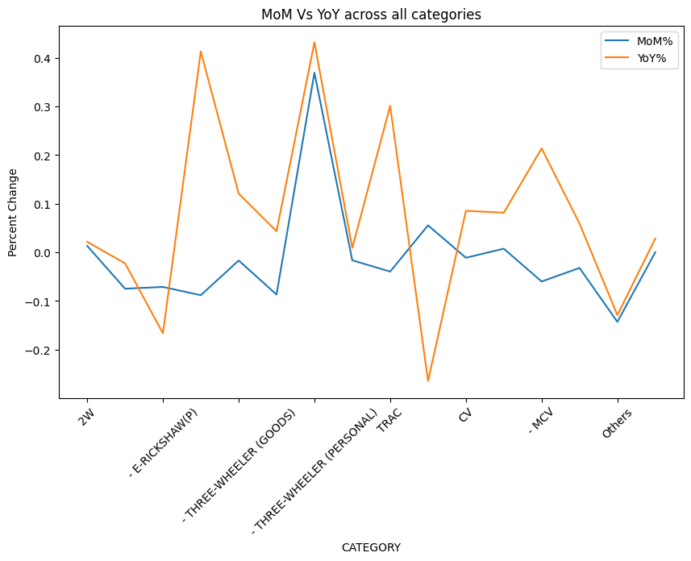
MoM Insights (July → August 2025)
Strong month-on-month growth:
Three-wheeler (Passenger, Goods, E-Rickshaw) show sharp positive jumps, suggesting rising demand in urban mobility and last-mile transport.
Tractors (TRAC) also post healthy MoM growth → driven by monsoon progress and rural sentiment.
Weak month-on-month performance:
(2W) and E-Rickshaw(P) dipped slightly, suggesting consumers might be waiting for festive promotions before making purchases.
YoY Insights (Aug 2024 → Aug 2025)
Strong annual growth:
Three-wheeler categories (especially passenger and personal) show YoY gains, reflecting rising urban demand for shared mobility and affordability.
MCVs (medium commercial vehicles) also see YoY growth, pointing to infrastructure and logistics expansion.
Weak annual growth:
E-Rickshaw(P) and CVs are slightly negative YoY, suggesting challenges in higher-capacity electric adoption and heavy transport.

Slide 9
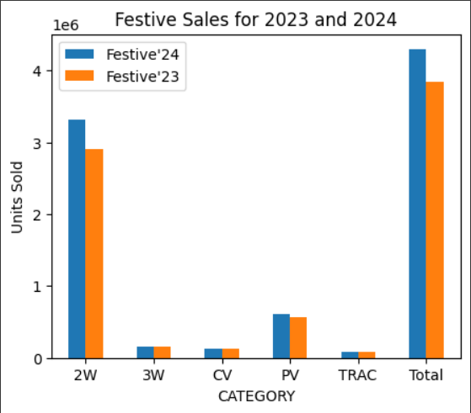
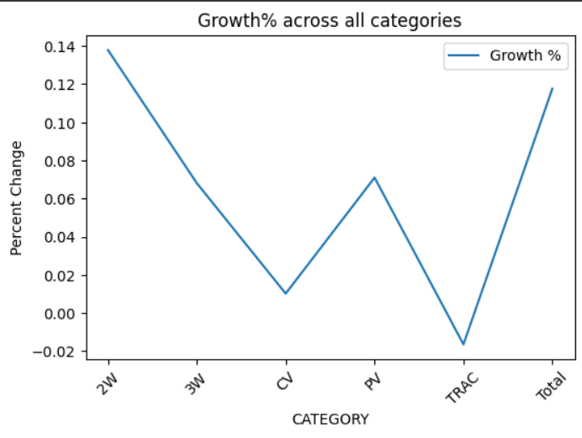
Insights
Two-Wheelers led in overall volume and saw a clear increase from the previous year.
Most categories recorded higher sales in 2024, except for Tractors.
Passenger and Commercial Vehicles maintained steady growth.
Total festive sales increased, reflecting overall market improvement.
Insights
Two-Wheelers had the highest growth among all categories.
Tractors showed negative growth, indicating a decline in sales.
Commercial Vehicles and Three-Wheelers saw minimal positive growth.
Passenger Vehicles experienced moderate growth.
Overall category growth was strong and positive.

Slide 10



RECCOMENDATIONS TO CONSIDER
this festive season
Price Sensitivity with Timing
In the 2W and PV segments, consumers are demonstrating higher price consciousness. Many prefer to delay purchases until the festive period when they can take advantage of bundled discounts, low-interest financing, and exchange bonuses. This suggests that festive sales spikes are less about latent demand and more about strategic timing of purchases to maximize value.
The strong momentum in 3W passenger and goods categories indicates that affordability and shared transport remain central to urban consumer behaviour. Rising fuel prices and congestion have made cost-efficient last-mile solutions attractive, particularly for gig workers and small businesses. This reflects a shift in urban demand patterns from personal ownership to shared, utility-driven mobility.
Growing Urban Mobility Demand
Rural Sentiment Boost
Positive monsoon conditions and supportive government policies are expected to lift disposable incomes in rural India. This has a direct spillover effect on tractor and 2W demand, as these vehicles are essential for both livelihood and personal mobility in non-urban areas. With festive months aligning with harvest income, rural buyers are likely to demonstrate higher purchasing power and confidence this year.

Slide 11


Thank YOU
By Shreeya
sgofficial9999@gmail.com
Github Code - Link

